Slide 1
A Transport Policy for Sri Lanka ?
Eng Parakrama Jayasinghe
Member of Expert Committee on Mitigation
Climate Change Secretariat

Slide 2
An urgent Need due to many aspects
Sri Lanka has no transport policy
Many discussions have taken place with no coherent national policy accepted and adopted to implement
A proper Transport Policy would have a direct impact on the
  Economy
  Environment
  Balance of Payment
  Social well being
  Insulation on future shocks

Slide 3
A much detailed an in depth study is needed, But an important step can be taken urgently !
A comprehensive transport policy can emerge only after a detailed study and widespread consultation with all affected stake holders
However, correct decisions made under present circumstances could have a positive or negative impact on such a policy even if such effort is made
Some visionary practical decisions can be made at present focusing on the events in the recent years both locally and internationally in the areas of technology, finances, balance of payment issues, world and social political scenarios
This is in the area of future Transport Energy Options for Sri Lanka

Slide 4
The current Status on Transport fuels
Nearly 100 % dependent on imported fossil fuels
Highly volatile costs totally out side our control
Major cause of continued drain in Foreign Exchange up to $ 4,000 Million annually on fuel imports only. This can only increase
Major contributor to atmospheric pollution in Colombo and other cities. ( The positive change was seen during Covid and later fuel shortages)
Un accounted additional drain on import of spares
Very heavy expense to vehicle users on initial capital, fuel and maintenance.
Large increase in inefficient modes of vehicles with very low transport efficiencies such as 3W and private cars
Cause of massive road congestion.

Slide 5
LOCAL SCENARIO
  Vehicle Fleet in Sri Lanka
  Ø Average usage and fuel economy
Vehicle Type | Average km/yr | Fuel Economy (km/l)
Cars- Gasoline | 8,000 | 7.5
Cars- Diesel | 15,000 | 11.0
Dual Purpose- Gasoline | 8,000 | 6.0
Dual Purpose- Diesel | 21,000 | 8.3
Buses - Diesel | 41,000 | 3.2
Lories - Diesel | 52,000 | 3.5
Motor Cycles - Gasoline | 6,225 | 23.5
Motor Tricycles - Gasoline | 12,000 | 19.0
  Fuel Economy: Liters per Passenger km
  Bus : 0.01 liter/passenger km
  Car : 0.05 liter/passenger km
  3 W : 0.04 liter/passenger km
  2 W : 0.02 liter/passenger km
  Fuel Consumption in Transport Sector:
  Gasoline : 400 Million liters
  Diesel : 1200 Million liters

Slide 6

Transportation is main consumer of petroleum fuels
Source: SEA
Source: CEYPETCO
Notes:
The Transport Sector is the dominant user of liquid fuels with 70 percent of oil used in 2011. This percentage will only increase as the vehicle fleet increases. Unfortunately, the transportation sector is an inefficient user of liquid fuels. Sri Lanka uses 21 percent of its total energy for transport, compared to 7% in India and 16% in Thailand and 19% in Malaysia. These other countries are much larger countries with longer transport distances.
Inefficiencies arise from: Congestion (average speeds in W. Province ~15 km/hr and 25 km/hr islandwide); Inadequate attention to mass transit; Combustion inefficiencies of the vehicles; and Poor use of railway assets
Inefficient consumption is made worse by subsidies. A January 2013 IMF report, ENERGY SUBSIDY REFORM: LESSONS AND IMPLICATIONS, notes that post-tax energy subsidies in Sri Lanka in 2011 as a percent of government revenues were 19.2% of which petroleum subsidies were 13.9% and Electricity 5.2%, equal to Rs 183 billion. This is on top of the losses incurred by CEB and CPC.
While aimed at protecting consumers, subsidies aggravate fiscal imbalances, crowd-out priority public spending, and depress private investment, including in the energy sector. Subsidies also encourage excessive energy consumption, reduce incentives for investment in renewable energy and energy efficiency. Most subsidy benefits are captured by higher-income households, reinforcing inequality.
Petroleum imports though essential pose major macro-economic and balance of payment risks. These imports do not add to Sri Lanka’s GDP, except for domestic value added in refining, storage and distribution. Petroleum imports are expected to grow steadily as the chart from CEYPETCO shows requiring USD 4 billion by 2020.

Slide 7
What led to the present mess
The share of public transport has continually deteriorated without any effort for correction. A lot of talk and discussions not resulting in any viable actions
Electrification of rail to attract more passengers off the road not implemented
The political support for more and more three wheelers has added to the congestion , ostensibly supported in the interest of poorer passengers, not admitting the lack of effort to provide good public transport, which was available in the past, destroyed by irrational and unplanned, unregulated privatization
Pushing the people to somehow get a personal vehicle causing many to financial dangers and unsustainable debt commitments
The policy statement in the National Energy Policy Gazetted in Aug 2019 stating that 25 %of Light vehicles will be EVs by 2023 under lines the lack of validity and value of such policy documents

Slide 8
Positive Trends making a change viable in short term
The crisis of covid and lack of FOREX caused the banning of imports, which must be looked at positively making it possible to charter a different path for the future
Sri Lanka already has more than enough light vehicles . Any more additions will exacerbate the road congestion which has reduced the average speed on Colombo roads to less than 12 km/hr.
Have saved over $ Million spent annually on import of vehicles which only helps a minority of traders at great financial and economic loss to the country
The change over to more efficient and environmental friendly . Far more economical to operate and devoid of any need for imported fossil fuels is now possible and commercially proven world over. Only miniute acceptance in Sri Lanka

Slide 9
Why EVs
The main reason for the change over is to save $ 4,000,000 foreign exchange on transport fuel
The zero emission form EVs will automatically provide the means of achieving the target set by the NDA on transport.
Much lower cost of operation to the owner with 80% energy effcienty Vs 15% for Petrol or Diesel Machines. Cost is as low as Rs 2.50 per km by charging at off peak hours from the grid or near zero if charged using solar power
Much lower cost of maintenance reducing the drain oon foreign exchange for import of spares.
Most importantly possibility of creating a local industry for converting over 3 Million light vehicles including 3 W and cars to EVs by competent local technicians without the need for new additions from abroad. This has already been commenced by David Peiris and Code Gen
All major automobile manufacturers have made plans to stop making and petrol or diesel vehicles by 2035.
Many countries have set time targets to reach 100% fossil fuel free transport

Slide 10
What about the larger vehicles?
For the near future they would need to be continued on fossil fuels.
But the possibility of converting the existing vehicles to run on Green Hydrogen generated using renewable energy is already proven . An increase of efficiency over % is possible with concurrent reduction of carbon emissions.
The busses used for public transport can be EVs in the short term. The current higher cost of EV busses can be recovered in a few years by the savings in fuel costs.
Railways offer a much more attractive option. Over 90% of our locomotives are actually run on electricity being Diesel Electrics.
They can be converted to run the diesel generators on Green Hydrogen generated by the SLR on its own using Solar or Wind at their own depots.
This will remove the need for expensive electrical over head electrical supply lines and make all routes to be electrified immediately .

Slide 11
Impact on Transport Cost across the board
Transport is major cost for all segments of the economy and for the people. The elimination of use of fossil fuels at ever increasing costs and paid for in Dolars will immediately reduce the cost of transport
The change over in Railways will have the most impact by reducing cost of fuel for SLR making them profitable to enable other investments to attract more passengers and cargo. The change is not limited to few corridors , but can be implemented island wide.
The reduction in emissions will enable targeting low cost funding from Green Carbon Fund

Slide 12
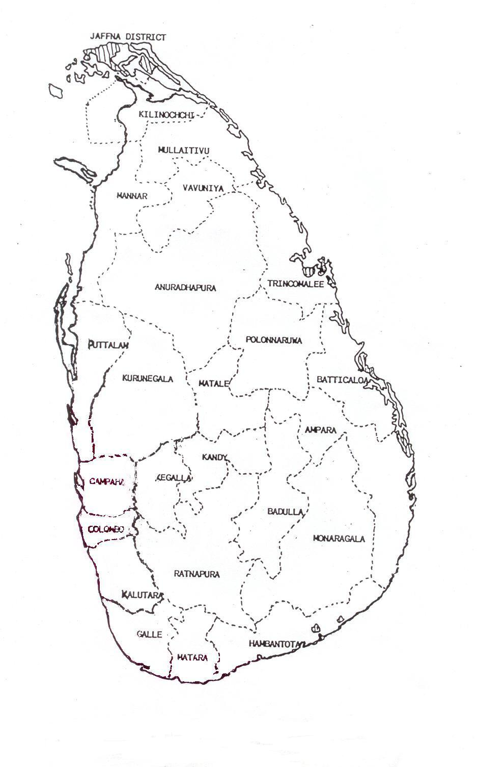
Converting the Drain to a ‘Spin’
Cost of Fuel Imports for Electricity and Transport
US $ 5000 Million and will continue to increase
The Burden
Convert to a Boon
Rs.
Rs.
CERS
$$$
CERS
$$$
$$$
Rs.
$
Cost of Energy and other imports
Draining the Economy
Value of Energy and local inputs
Catalysing the Economy !!

Slide 13
Barriers to the change
The first barrier is the lack of understanding of the transport authorities, who have not even bothered to draft and implement a National Transport Policy taking into account the ground shaking changes in technologies and innovations in recent years.
There would be many barriers created by the small group of people who thrive on dependence on fossil fuel driven vehicles both for import of vehicles, spares and the fuel itself. The larger as interest of the country must prevail over such narrow limited interest.
They would try to portray false arguments such as economic revival by relaxing imports of vehicles, ignoring the very negative impact on the BoP and thus driving up the Parity rate. It is the economies of the countries making the vehicles and supplying the fuel that would thrive not Sri Lanka
The major saving of foreign exchange must be the main driver.

